Slide 1


Python for Web Automation and Data Processing
| DevOps and Cloud Computing

Slide 2

Objective
Understand the fundamentals of web automation and HTTP requests.
Use Beautiful Soup for web scraping and data extraction.
Process and manipulate structured data using Pandas and NumPy.
Apply automation techniques for common tasks like data extraction and transformation.

Slide 3
Introducing web automation and how Python interacts with web pages
| DevOps and Cloud Computing

Slide 4
Web automation
Introduction to Web Automation
Web automation involves using software tools and scripts to perform tasks on web pages without manual intervention.
It is commonly used for testing, data scraping, form submissions, and repetitive browser interactions.

Slide 5
Web automation
How Python Interacts with Web Pages
Python interacts with web pages using libraries like:
Selenium – Automates browsers for testing and web interactions.
Beautiful Soup – Parses HTML and extracts data from web pages.
Requests – Sends HTTP requests to fetch web content.
Playwright – A modern automation framework for faster and more reliable browser control.

Slide 6
Explaining HTTP requests and responses (GET, POST).
| DevOps and Cloud Computing

Slide 7
HTTP requests & responses
The Hypertext Transfer Protocol (HTTP) enables communication between a client (browser or script) and a server. It works through requests sent by the client and responses returned by the server.
HTTP Requests
An HTTP request consists of:
Method (GET, POST, etc.)
URL (the resource being accessed)
Headers (metadata like content type and authentication)
Body (data sent in requests like form submissions)

Slide 8
HTTP requests & responses
Common HTTP Methods
1. GET – Retrieves data from a server.
Example: Fetching a webpage (GET /home).
No request body; parameters are in the URL.
2. POST – Sends data to the server to create or update a resource.
Example: Submitting a login form (POST /login).
Data is included in the request body.

Slide 9
HTTP requests & responses
HTTP Responses
A response includes:
Status Code (e.g., 200 OK, 404 Not Found, 500 Internal Server Error)
Headers (metadata like content type and caching policies)
Body (HTML, JSON, or other response data)

Slide 10
Demonstrating using the requests library to fetch web page content
| DevOps and Cloud Computing

Slide 11
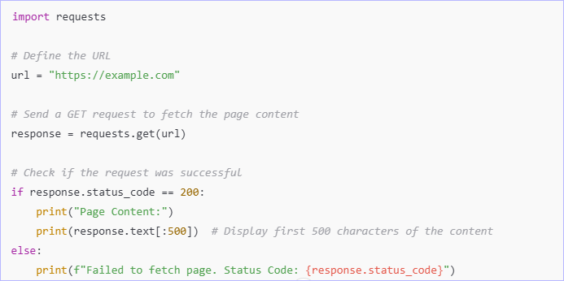
Let’s do it
Here’s a simple example using the ‘requests’ library to fetch web page content:

Slide 12
The concept of web scraping and ethical considerations
| DevOps and Cloud Computing

Slide 13
Web scraping & ethical considerations
Web scraping is the process of extracting data from websites using automated scripts. It involves sending HTTP requests, parsing HTML content, and retrieving structured data. Python libraries like Beautiful Soup, Requests, and Scrapy are commonly used for web scraping.
Ethical Considerations
Respect ‘robots.txt’ – Check a website’s ‘robots.txt’ file to see what is allowed.
Avoid Overloading Servers – Use rate limiting to prevent excessive requests.
No Unauthorized Data Use – Do not scrape personal, copyrighted, or sensitive data.
Follow Website Terms – Ensure compliance with legal and ethical guidelines.

Slide 14
Introducing BeautifulSoup and demonstrating parsing HTML
| DevOps and Cloud Computing

Slide 15
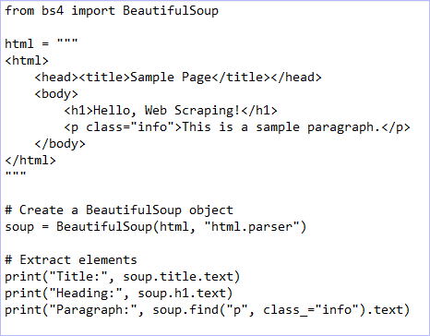
Let’s do it
‘BeautifulSoup’ is a Python library used for parsing HTML and XML documents. It helps extract data from web pages by navigating the HTML structure.
Example: Parsing HTML with BeautifulSoup

Slide 16
Pop Quiz
Q. Which library is commonly used with BeautifulSoup to fetch web page content?
A
B
NumPy
Requests

Slide 17
Pop Quiz
Q. Which library is commonly used with BeautifulSoup to fetch web page content?
A
B
NumPy
Requests

Slide 18
Demonstrating extracting specific elements from a webpage
| DevOps and Cloud Computing

Slide 19
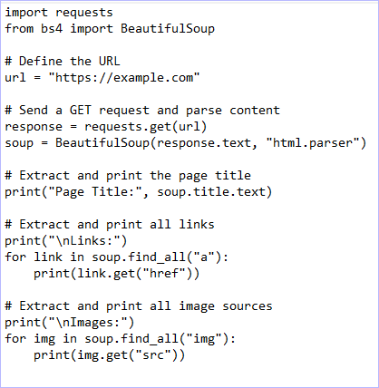
Let’s do it
Example: Extracting Title, Links, and Images

Slide 20


Take A 5-Minute Break!
Stretch and relax
Hydrate
Clear your mind
Be back in 5 minutes

Slide 21
Introducing the importance of structured data processing
| DevOps and Cloud Computing

Slide 22
Structured data processing
Structured data processing is crucial for efficiently organizing, analyzing, and utilizing information. It ensures data consistency, accuracy, and accessibility, making it easier for applications, databases, and AI models to interpret and process information effectively.
Key Benefits:
Data Consistency – Ensures uniform formatting and organization.
Efficient Analysis – Enables faster querying, filtering, and reporting.
Automation & Scalability – Facilitates seamless data handling in web scraping, ETL (Extract, Transform, Load), and AI applications.
Interoperability – Structured data can be easily shared across systems using formats like JSON, CSV, or databases.

Slide 23
Demonstrating creating and manipulating data with Pandas
| DevOps and Cloud Computing

Slide 24
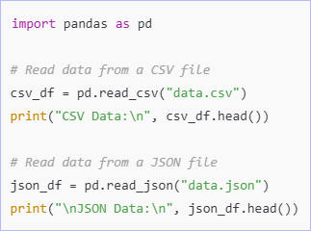
Let’s do it
‘pandas’ is a powerful Python library for working with structured data, enabling easy data reading, filtering, sorting, and aggregation.
1. Read Data from CSV and JSON Files:

Slide 25
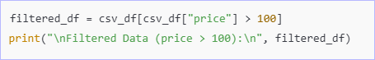
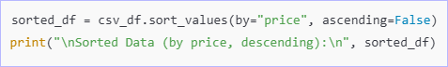
Let’s do it
2. Filtering Data (e.g., Select rows where price > 100):
3. Sorting Data (e.g., Sort by price in descending order):

Slide 26
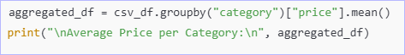
Let’s do it
4. Aggregation (e.g., Calculate average price per category):

Slide 27
Pop Quiz
Q. Which library is primarily used for data manipulation in Python?
A
B
Pandas
NumPy

Slide 28
Pop Quiz
Q. Which library is primarily used for data manipulation in Python?
A
B
Pandas
NumPy

Slide 29
Introducing NumPy for numerical processing
| DevOps and Cloud Computing

Slide 30
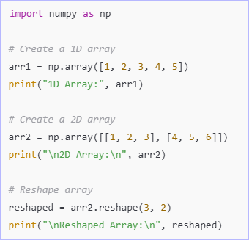
NumPy
NumPy (Numerical Python) is a powerful library for handling large datasets, performing mathematical operations, and working with multidimensional arrays efficiently. It is widely used in data science, machine learning, and scientific computing.
1. Creating and Manipulating Arrays:

Slide 31
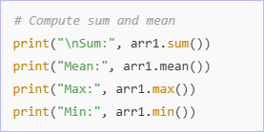
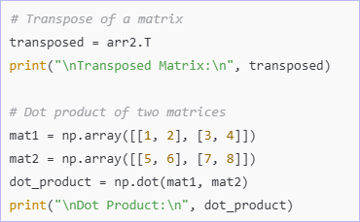
NumPy
2. Basic Operations (Mean, Sum, etc.):
3. Matrix Transformations (Transpose & Dot Product):

Slide 32
Pop Quiz
Q. What is NumPy primarily used for?
A
B
Numerical computing and array manipulation
Machine learning model training

Slide 33
Pop Quiz
Q. What is NumPy primarily used for?
A
B
Numerical computing and array manipulation
Machine learning model training

Slide 34
Discuss real-world automation scenarios
| DevOps and Cloud Computing

Slide 35
Real-world automation scenarios
Automation plays a crucial role in reducing manual effort, increasing efficiency, and improving accuracy in various domains. Here are some key use cases:
1. Web Scraping for Data Collection:
Use Case: Businesses and researchers collect data from websites to analyze trends, monitor competitors, or gather public information.
Example:
Extract product prices from e-commerce websites.
Gather news articles from multiple sources for sentiment analysis.
Tools:
BeautifulSoup and Requests for static pages.
Selenium or Playwright for dynamic content.

Slide 36
Real-world automation scenarios
2. Extracting Data from Reports & Transforming It into Structured Formats
Use Case: Companies automate the processing of reports (PDFs, CSVs, JSON) to extract relevant data and store it in databases.
Example:
Convert financial statements from PDFs into structured Excel sheets.
Extract log data and transform it into structured formats for analytics.
Tools:
pandas for handling structured data.
PyPDF2 or pdfplumber for extracting text from PDFs.
openpyxl for working with Excel files.

Slide 37
Real-world automation scenarios
3. Automating Repetitive Web Tasks (e.g., Form Submissions)
Use Case: Automating interactions with web applications, such as filling forms, logging into portals, or data entry.
Example:
Auto-filling job application forms.
Automating login processes and downloading reports.
Tools:
‘Selenium’ or ‘Playwright’ for browser automation.
‘pyautogui’ for GUI-based automation when a web API isn't available.

Slide 38
Time for case study!

Slide 39
Important
Complete the post-class assessment
Complete assignments (if any)
Practice the concepts and techniques taught in this session
Review your lecture notes
Note down questions and queries regarding this session and consult the teaching assistants

Slide 40
Thanks!

